Slide 1



Amazon Web Services
(AWS)
1. Introduction – what is cloud computing

Slide 2
what is cloud computing?
Cloud computing is the on-demand delivery of compute power, database storage, application, and other IT resources
Through a cloud service platform, you're going to get a pay-as-you-go pricing
You can provision exactly the right type and size of computing resources you need
You can access as many resources as you need, almost instantly
Simple way to access servers, storage, databases and a set of application services
Amazon Web Services owns and maintains the network-connected hardware required for these applications services, while you provision and use what you need via a web application.

Slide 3
The Deployment Models of the Cloud
Private Cloud:
Cloud services used by a single organization, not exposed to the public
Complete control
Security for sensitive applications
Meet specific business needs
Public Cloud:
Resources owned and operated by a third-party cloud service provider delivered over the internet
All advantages of cloud computing
Hybrid Cloud:
Keep some servers on premises and extend some capabilities to the Cloud
Control over sensitive assets in your private infrastructure
Flexibility of cost-effectiveness of the public cloud

Slide 4
Characteristics of Cloud Computing
On-demand self service:
  User can provision resources and use them without human interaction from the service provider
Broad network access:
  Resources available over the network, and can be accessed by diverse client platforms
Multi-tenancy and resource pooling:
  Multiple customers can share the same infrastructure and applications with security and privacy

Slide 5
Characteristics of Cloud Computing
Rapid elasticity and scalability :
  Automatically and quickly acquire and dispose resources when needed
  Quickly and easily scale based on demand
Measured service:
  Usage is measured, users pay correctly for what they have used

Slide 6
Advantages of Cloud Computing
Trade capital expense (CAPEX) for operational expense (OPEX)
  Pay On-Demand: don’t own hardware
  Reduced Total Cost of Ownership (TCO) & Operational Expense (OPEX)
Benefit from massive economies of scale
  Prices are reduced as AWS is more efficient due to large scale
Stop guessing capacity
  Scale based on actual measured usage
Increase speed and agility
Stop spending money running and maintaining dat centers
Go global in minutes: leverage the AWS global infrastructure

Slide 7
Problems Solved by the Cloud
Flexibility: change resources types when needed
Cost-Effectiveness: pay as you go, for what you need
Scalability: accommodate larger loads by making hardware stronger or adding additional nodes
Elasticity: ability to scale out and scale-in when needed
High-availability and fault-tolerance: build across data centers
Agility: rapidly develop, test and launch software applications

Slide 8
Types of Cloud
Infrastructure as a Service (IaaS):
  Provide building blocks for cloud IT
  Provides networking, computers, data storage space
  Highest level of flexibility
  Easy parallel with traditional on-premises IT
Platform as a Service (PaaS)
  Removes the need for your organization to manage the underlying infrastructure
  Focus on the deployment and management of your applications
Software as a Service (SaaS)
  Completed product that run and managed by the service provider

Slide 9
Cloud Types – Comparison
On-premises
IaaS
PaaS
SaaS
Applications
Applications
Applications
Applications
Data
Data
Data
Data
Runtime
Runtime
Runtime
Runtime
Middleware
Middleware
Middleware
Middleware
OS
OS
OS
OS
Virtualization
Virtualization
Virtualization
Virtualization
Servers
Servers
Servers
Servers
Storage
Storage
Storage
Storage
Networking
Networking
Networking
Networking
Mange by You
Mange by Others

Slide 10
Types of Cloud
Infrastructure as a Service (IaaS):
  Amazon EC2 (on AWS)
  GCP, Azure, Rackspace, Digital Ocean, Linode
Platform as a Service (PaaS)
  Elastic Beanstalk (On AWS)
  Heroku, Google App Engine (GCP), Microsoft Azure
Software as a Service (SaaS)
  Many AWS services (ex: Rekognition for Machine Learning)
  Google Apps (Gmail), Dropbox, Zoom

Slide 11
AWS Pricing Overview
AWS has 3 pricing fundamentals, following the pay-as-you-go pricing
  Compute
    Pay for compute time
  Storage
    Pay for the data stored in cloud
  Data transfer OUT of the cloud:
    Data transfer IN is free
◆ All of the above solves the expensive issue of traditional IT

Slide 12




AWS Cloud History
2002:
Internally
launched
2004:
Launched publicly
With SQS
2007:
Launched in
Europe
2003:
Amazon Infrastructure is
One of their core strength.
Idea to market
2006:
Re-launched
Publicly with
SQS, S3 & EC2

Slide 13
AWS cloud Use Cases
AWS enables you to build sophisticated, scalable applications
Applicable to a diverse set of industries
Use cases include
  Enterprise IT, Backup & Storage, Big Data analytics
  Website hosting, Mobile & Social Apps
  Gaming
  Many more…

Slide 14
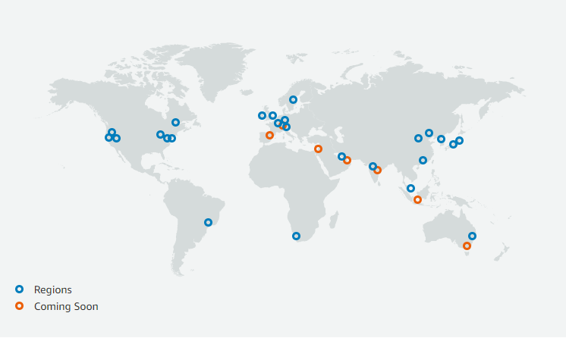
AWS Global Infrastructure
AWS Regions
AWS Availability Zones
AWS Data Centers
AWS Edge Locations / Point of Presence
https://infrastructure.aws

Slide 15
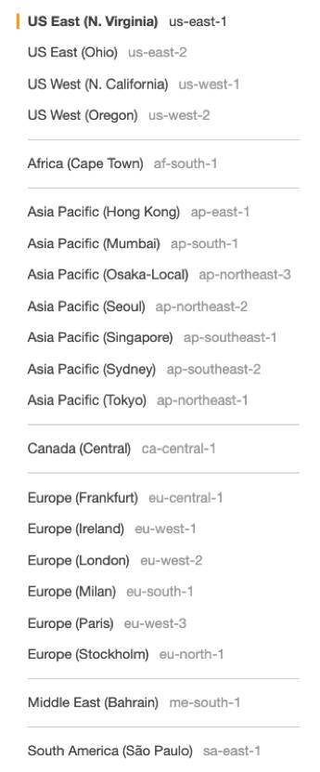
AWS Regions
AWS has Regions all around the world
Names can be us-east-I, eu-west-3…
A region is a cluster of data centers
Most AWS services are region-scoped
  If we use a service in one region and we try to use it in
  another region, it will be like a new time of using the service.

Slide 16
How to choose AWS Region?
Choosing a region depends on many factors, here are some that may impact your choice:
  Compliance with data governance and legal requirements: data never leaves a region without your explicit permission
  Proximity to customers: reduced latency
  Available Services within a Region: new services and new features aren’t available in every Region
  Pricing: pricing varies region to region and is transparent in the service pricing page

Slide 17
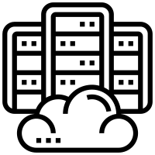
AWS Availability Zones
  Each region has many availability zones (usually 3, min is 2, max is 6). Example:
    ap-southeast-2a
    ap-southeast-2b
    ap-southeast-2c
  Each availability zone (AZ) is one or more discrete data centers with redundant power, networking and connectivity
  They’re separate from each other, so that they're isolated from disasters
  They’re connected with high bandwidth, ultra-low latency networking
AWS Region
Sydney: ap-southeast-2
Ap-southeast-2a
Ap-southeast-2b
Ap-southeast-2c

Slide 18
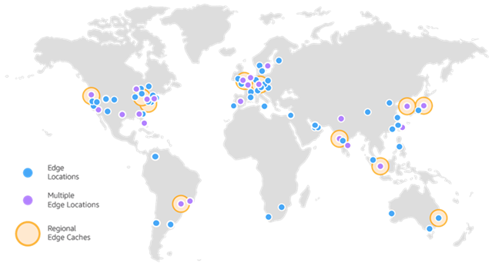
AWS Points of Presence (Edge Locations)
  Amazon has 216 Point of Presence in 84 cities across 42 countries
  Content is delivered to the end users with lower latency

Slide 19
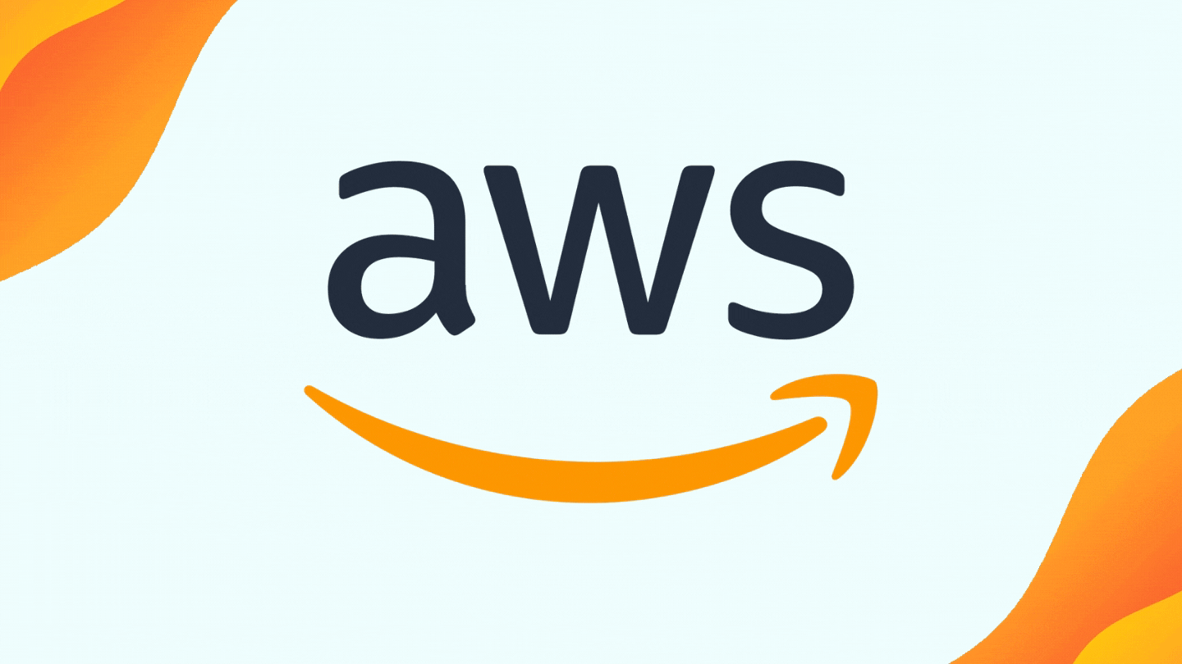
Demo – tour of the AWS Console
AWS has Global Services:
  Identity and Access Management (IAM)
  Route 53 (DNS service)
  CloudFront (Content Delivery Network)
  WAF (Web Application Firewall)
Most AWS services are Region-scoped:
  Amazon EC2 (Infrastructure as a Service)
  Elastic Beanstalk (Platform as a Service)
  Lambda (Function as a Service)
  Rekognition (Software as a Service)
Region Table: https://aws.amazon.com/about-aws/global-infrastructure/regional-product-services/

Slide 20
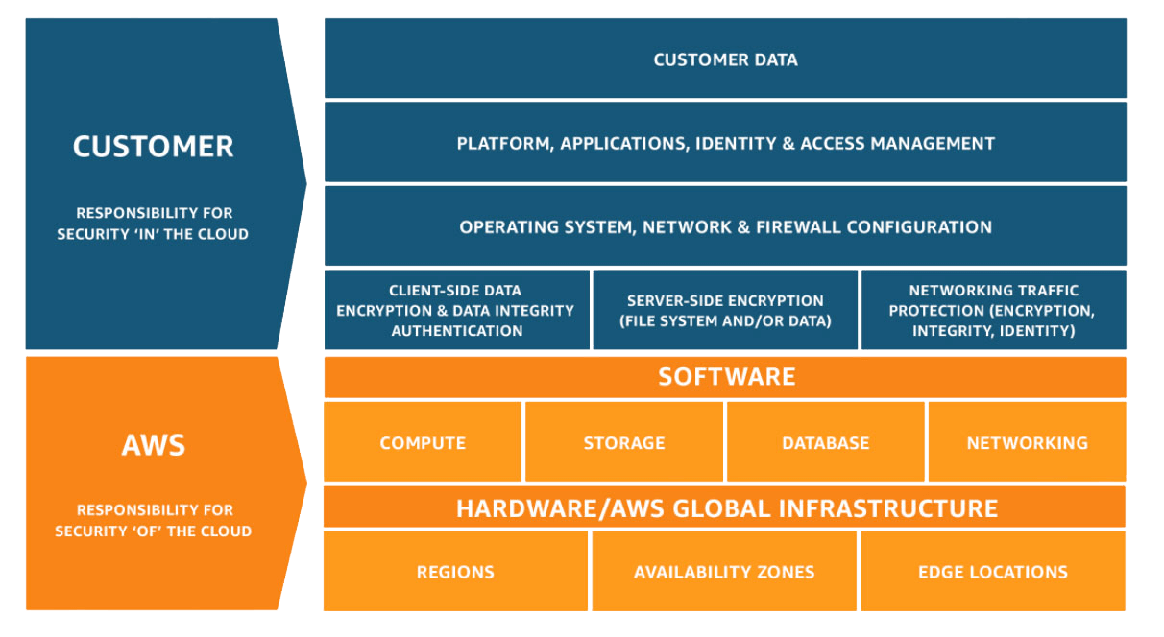

Shared Responsibility Model diagram
Customer = responsibility for the security in the cloud
AWS = responsibility for the security Of the cloud
https://aws.amazon.com/compliance/shared-responsibility-model/

